Slide 1
TEMPO Post-Launch Update
Raid M Suleiman, John E Davis, John C Houck, and LaRC TEMPO Team

Slide 2
Outline
TEMPO Systems
Instrument Simulator
Remote Monitor
Where is TEMPO now?
Commissioning (Details)
Summary

Slide 3
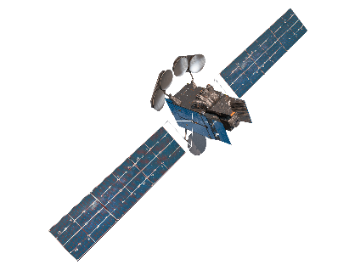
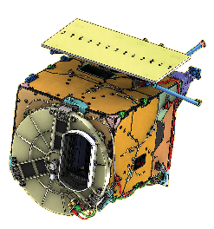


TEMPO System
Mission Data (TEMPO)
IS-40e
Housekeeping Telemetry
Commanding
TEMPO Instrument
Intelsat
Smithsonian Astrophysical Observatory
Spacecraft Operations Center
Spacecraft Command Generation
Satellite H&S Monitoring
Data Products
Command
Loads
Instrument Operations Center
Planning
Instrument Command Load Generation
Instrument Health & Status Monitoring
NASA LaRC ASDC
Raw & Processed Data
Storage & Distribution
TT&C Station
Planning Aids
Mission Data,
Ancillary Data
Riverside Ground Station
Raw Science & Ancillary Data
Queuing & Distribution
Science Data Processing Center
Science Data Processing
Image Navigation and Registration
Command Load Planning and Input
Publicly Released Data Products
Ancillary Data
Ancillary Data
Sources
Science Data User

Slide 4
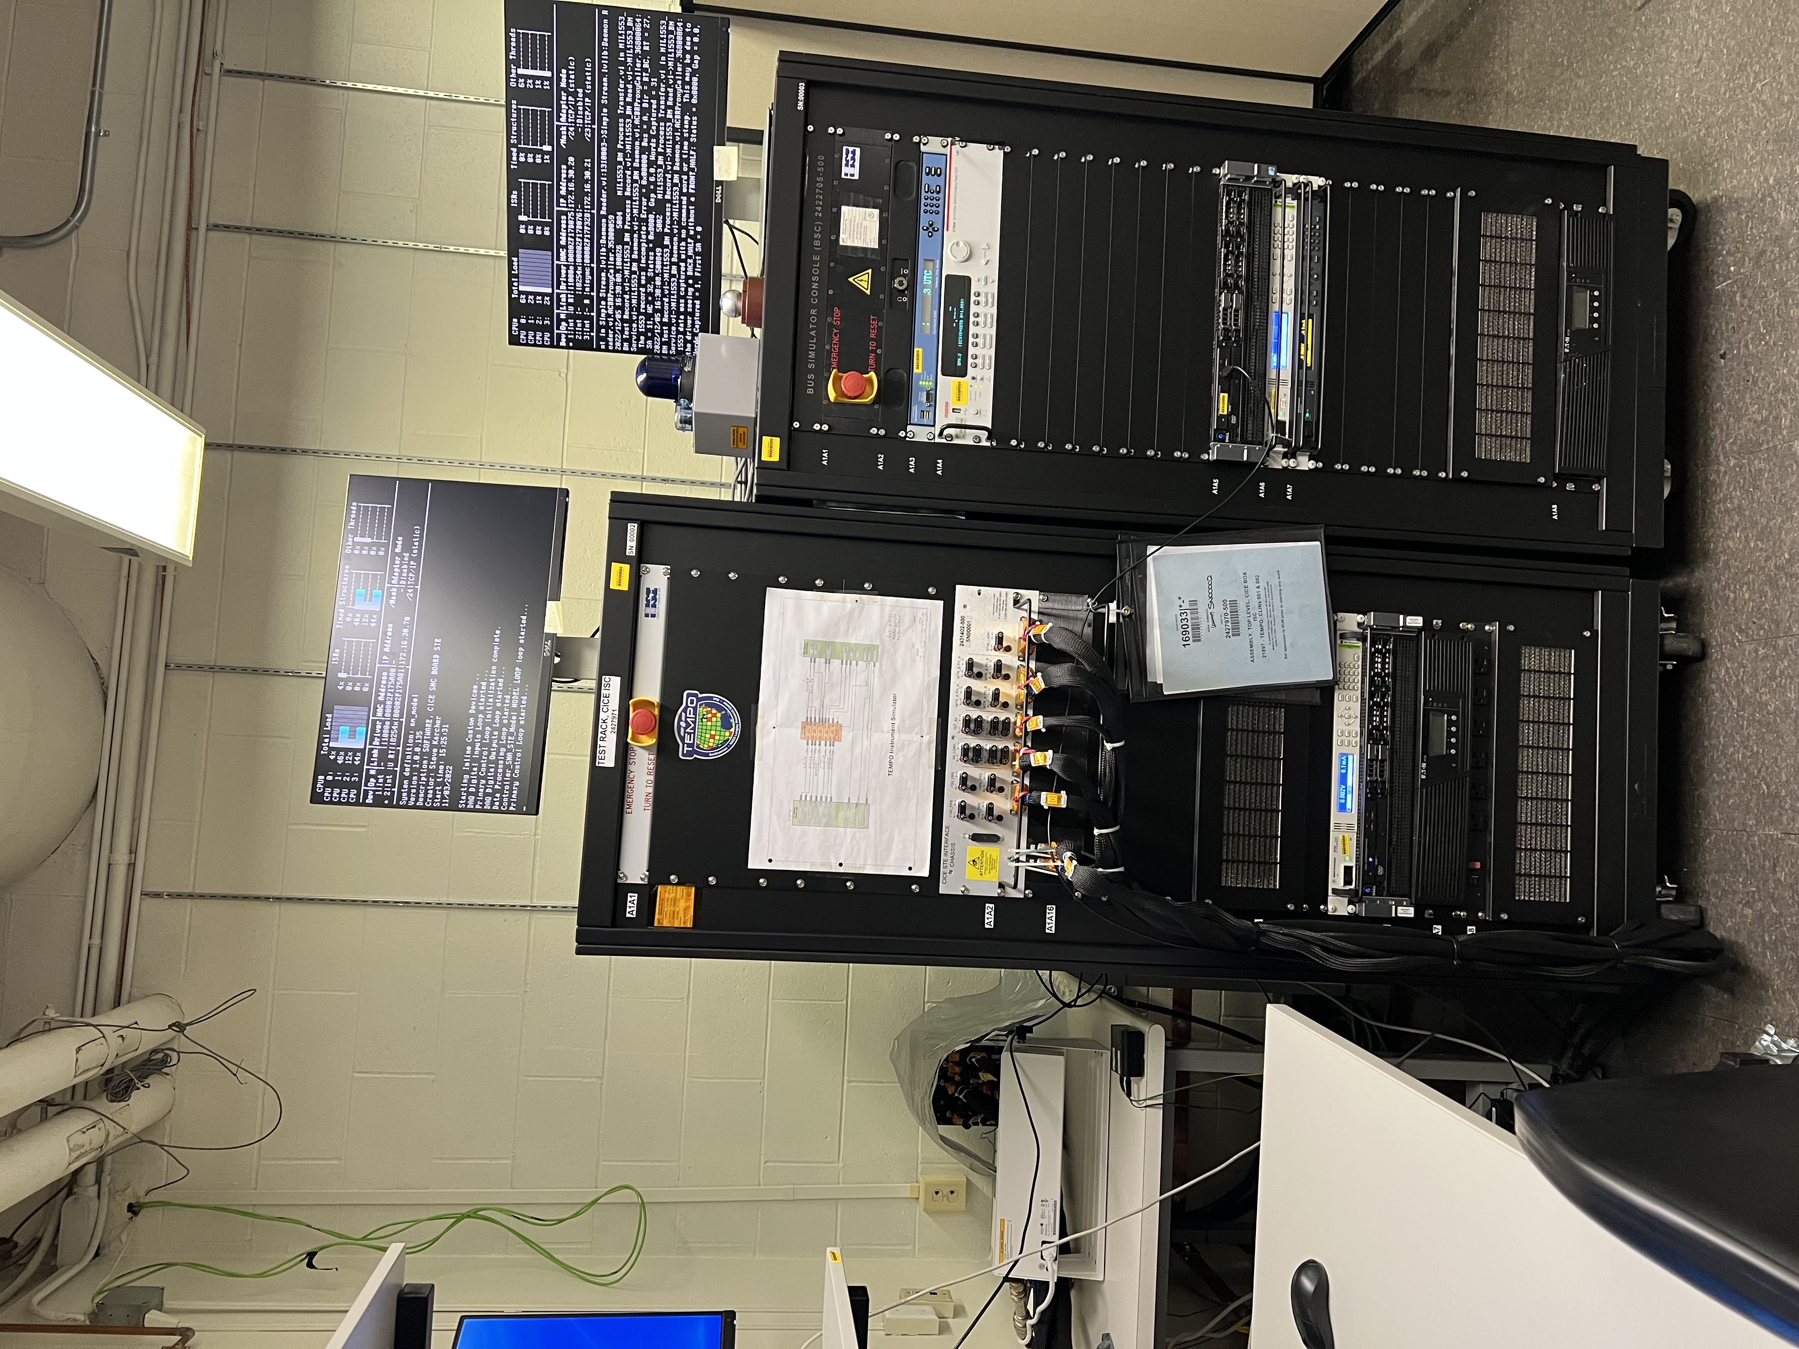
Instrument Simulator
The TEMPO Instrument simulator consists of:
Instrument Control Electronics (ICE)
Instrument Simulator Console (ISC)
Bus Simulator Console (BSC)
B
C
A
Keycard access, only
May 2, 2023

Slide 5
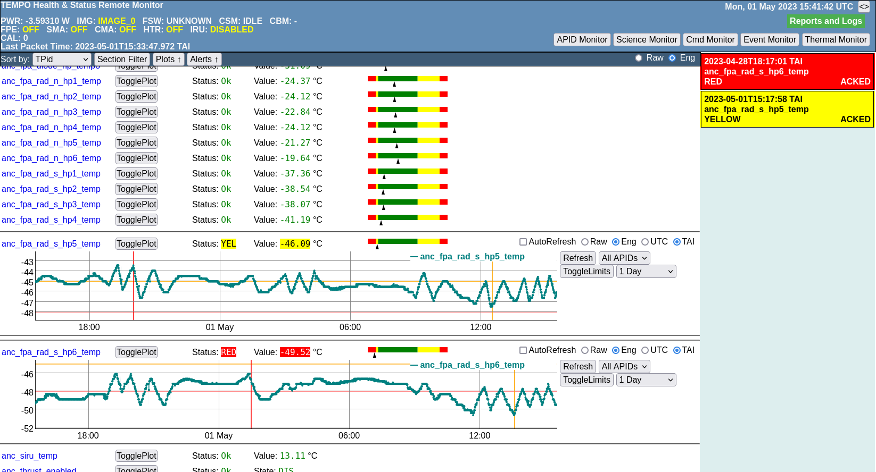
Remote Monitor

Slide 6
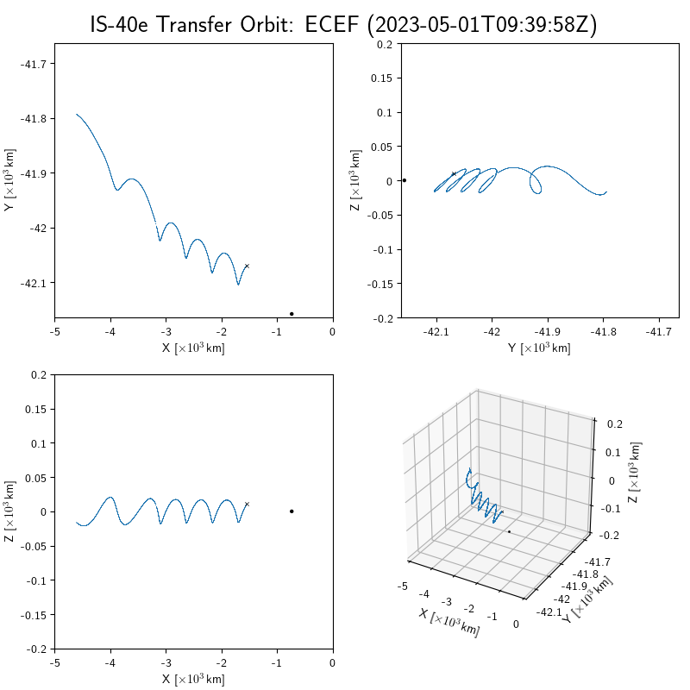
Where TEMPO is Now?
Orbit drift between April 26 and May 1.
The current spacecraft position is marked with an "x” (at 2023-05-01-05:39:58 AM EDT).
The target geostationary position (-91W) is marked with a solid dot.
Notes:
The spacecraft position in coordinates that are fixed to the Earth (ECEF=Earth-Centered Earth-Fixed)

Slide 7
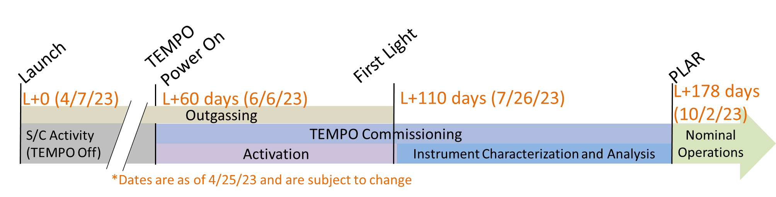
Commissioning Timeline

Slide 8
Activation Phase
Initial Power On
Dry Out (28 day)
Test Pattern Data Transfer
Cooldown to Operational Temperatures
Dark Collects
Calibration Wheel Checkout – Reference movements
SMA Tuning
Command Load Testing
Calibration Wheel Checkout – Absolute movements
First Light
Working Diffuser Linearity Calibration

Slide 9
Instrument Characterization and Analysis (ICA)
Refine Earth Imaging Parameters
Refine Solar Imaging Parameters
Characterize Dark Current
Characterize Field of Regard (FOR)
Prove Operations
ConOps Scanning
Optimized Scanning
Boresight Analysis of Solar Calibrations
Evaluation of the SSIRU Corrupt Message Rate Limit
City Lights Observations

Slide 10
TEMPO Commissioning Phase Activation

Slide 11
TEMPO Commissioning Phase Instrument Characterization and Analysis

Slide 12
TEMPO Commissioning Phase Instrument Characterization and Analysis

Slide 13
TEMPO Commissioning Phase Instrument Characterization and Analysis

Slide 14
Summary
All temperatures are nominal
SOOH: Radiator heatpipe temperatures can be allowed to drop to just below -60. The heat pipe radiator temperatures of -48C are not a concern, as they are rated to temperature of -60C.
Rehearsals are ongoing to practice all of the commissioning procedures
Ongoing work to validate any outstanding commands
Preparing for the ORR-Part 2 scheduled for May 17, 2023
A new IOC operator is joining the operations team within 2-3 weeks.
Notes:
SOOH - Spacecraft Orbital Operations Handbook

Slide 15
Backup

Slide 16
Response Time

Slide 17
Response Time

Slide 18
Commissioning Procedures (TEMPO-09-0037)
COM 001 – TEMPO Initial Power On
COM 002 – Initiate Dry out
COM 003 – Test Pattern Data Transfer
COM 004 – Post-Dry Out Cooldown
COM 005 – Dark Collection
COM 006 – Calibration Wheel Checkout Relative
COM 007 – SMA Tuning
COM 008 – Command Load Testing
COM 009 – First Light
COM 010 – Working Diffuser Linearity Calibration
COM 011 – Sample Imaging Parameters
COM 012 – Calibration Wheel Checkout Absolute
Commissioning procedures have been baselined

Slide 19
Nominal Operations Procedures (TEMPO-09-0031)
NOM 001 – Command Load Generation
NOM 002 – Command Load Verification
NOM 003 – Command Load Transfer
NOM 004 – SDPC Commanding Input File Generation
NOM 005 – Leap Second Management
NOM 006 – Spacecraft Time Clock
NOM 007 – Transient Special Observations
NOM 008 – Telemetry Monitoring
NOM 009 – Telemetry Trending
NOM 010 – Real-time Commanding
NOM 011 – SOC Notification of Unplanned Maneuver
NOM 012 – Return from Survival
NOM 013 – Return from Reset
NOM 014 – Return from SAFE
Nominal operations procedures have been baselined

Slide 20
Contingency Operations Procedures (TEMPO-09-0032)
TEMP Y – Yellow Temperature Limit Exceedance Response Procedure
TEMP R – Red Temperature Limit Exceedance Response Procedure
VOLT Y – Yellow Voltage Limit Exceedance Response Procedure
VOLT R – Red Voltage Limit Exceedance Response Procedure
FD1 – SAFE Mode FDIR Response Procedure
FD2 – Operational Heater Disabled FDIR Response Procedure
FD3 – Survival Mode FDIR Response Procedure
FD4 – Stepper Mode Overcurrent Response Procedure
ND1 – No Data Received by the IOC Response Procedure
ND2 – SDPC-ASDC Interface Malfunction Response Procedure
UEM1 – Unfamiliar Event Message Response Procedure
GPS Loss Response Procedure
Contingency operations procedures have been baselined

Slide 21
Mission Operations Team
Team consists of four personnel, trained as operators on all systems
Operations Manager
IOC Lead Operator
Responsible for IOC pipeline management and performing software updates
SDPC Lead Operator
Responsible for SDPC pipeline management and performing software updates
Operator (new hire)
Starting within 2 weeks

Slide 22
Operations Coverage
Normal operating hours for the TEMPO ground system
Nominal work week is 40-hours with 8-hour days
At least one operator will be on-site during normal hours
There is a single contact number and email for the SOC to contact the IOC
Outside normal working hours – One operator is on-call at all times
An on-call schedule will be established for each operator to be on-call for one week on a rotating basis
On-call covers all hours outside of the normal 40-hour week
Phone calls will be forwarded to the operator on call
Only 1 operator can be on AL and out of town for a given week

Slide 23
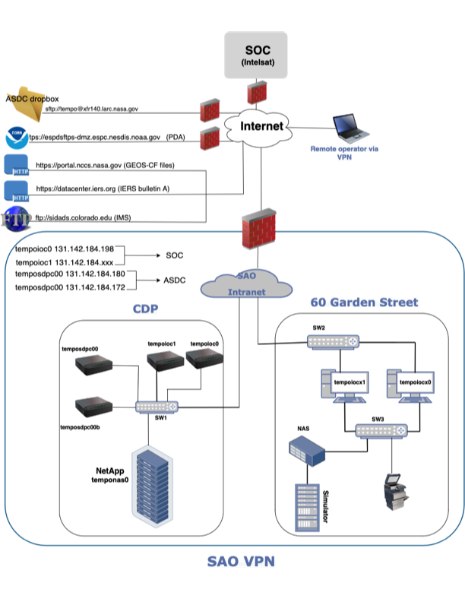
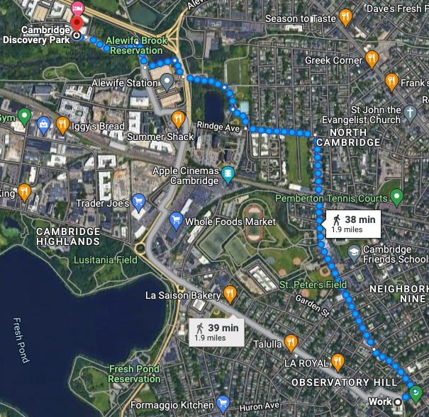
Detailed TEMPO GS Architecture + Physical map of facility locations
SAO - Locations
SAO Main offices: 60 Garden Street, Cambridge, MA
Cambridge Discovery Park (CDP): 31 Acorn Park Dr., Cambridge, MA
Cambridge Discovery Park, 31 Acorn Park Dr.
May 2, 2023
TEMPO Post-Launch Update
SAO Main Offices, 60 Garden Street

